Slide 1


Bash-Script Linux
Llenguatge shell script per Linux
Eduard Gutiérrez
Cristina Martinez
Raül Vallès
Dept. d’Informàtica

Slide 2
Introducció

Slide 3
Linux Kernel and Shell Scripting (I)
If you are using any major operating system you are indirectly interacting with the shell.
If you are running Ubuntu, Linux Mint, or any other Linux distribution you are interacting with the shell every time you use the terminal.
But before understanding shell scripting we have to get familiar with the following terminologies:
Kernel
Shell

Slide 4
Linux Kernel (I)
What is Kernel?
1. Kernel is core (main) part of Linux operating system.
2. It is collection of routine communicate with hardware directly.
3. It loads into memory when Linux is booted.
4. Kernel provides support to user programs through system call.
5. Kernel manages Computer memory, schedules processes, decides priorities of processes and performs other tasks.
6. Kernel does lot of work even if no application software is running.

Slide 5
Linux Kernel (II)

Slide 6
Shell ( I)
What is a Shell?
A shell is a special user program that provides an interface for users to use operating system(OS) services.
A Bash script is a plain text file which contains a series of commands. These commands are a mixture of commands we would normally type ouselves on the command line (such as ls or cp for example) and commands we could type on the command line but generally wouldn't (you'll discover these over the next few pages).
An important point to remember though is:
Anything you can run normally on the command line can be put into a script and it will do exactly the same thing. Similarly, anything you can put into a script can also be run normally on the command line and it will do exactly the same thing

Slide 7
Shell ( II)
There are two main shells in Linux:
The Bourne Shell: It is the most widely used shell in Linux systems and it can also be installed on Windows OS. The prompt for this shell is $ and its derivatives are:
POSIX shell also is known as SH
Korn Shell also known as KSH
Bourne Again SHell also knew as BASH
The C shell: The C shell’s syntax and usage are very similar to the C programming language and its prompt is %. Its subcategories are:
C shell also is known as Csh
Tenex C shell also is known as Tcsh

Slide 8
Shell Scripting ( I)
Why Do We Need Shell Scripts?
To avoid repetitive work
System admins use shell scripting for routine backups
For system monitoring
It is used to add new functionalities to the shell etc.

Slide 9
Shell scripting ( II)
Advantages Of Shell Scripts
The command and syntax are the same as those directly entered in the command line, so programmers do not need to switch to entirely different syntax
Writing shell scripts are much quicker
Quick start
Interactive debugging etc.

Slide 10
Shell scripting ( III)
Disadvantages Of Shell Scripts
Prone to costly errors, a single mistake can change the command which might be harmful
Design flaws within the language syntax or implementation
Not well suited for a large and complex task
Provide minimal data structure, unlike other scripting languages. etc

Slide 11
Primers passos

Slide 12
How does it work ( I)
In the realm of Linux (and computers in general) we have the concept of programs and processes.
A program is a blob of binary data consisting of a series of instructions for the CPU and possibly other resources (images, sound files and such) organized into a package and typically stored on your hard disk.
When we say we are running a program we are not really running the program but a copy of it which is called a process.
What we do is copy those instructions and resources from the hard disk into working memory (or RAM).
We also allocate a bit of space in RAM for the process to store variables (to hold temporary working data) and a few flags to allow the operating system (OS) to manage and track the process during it's execution.

Slide 13
How does it work ( II)
There could be several processes representing the same program running in memory at the same time.
For example I could have two terminals open and be running the command cp in both of them.
In this case there would be two cp processes currently existing on the system.
Once they are finished running, the system then destroys them and there are no longer any processes representing the program cp.
When we are at the terminal we have a Bash process running in order to give us the Bash shell.
If we start a script running it doesn't actually run in that process but instead starts a new process to run inside.

Slide 14
Writing my first script (I)
They are written using text editors and are then given permission to be executed by the system.
Listed below are the steps in creating a Shell Script:
Create a file using:
If you only have terminal: a vi editor (or any other editor like vim, nano )
If you have GUI ( in Linux, for Windows you probably need WSL installed):
JetBrains ( Pycharm, WebStorm, IntelliJIdea + ShellScript plugin ( Marketplace)
Visual Studio Codium + Package Bash Script
If you have internet connection and a browser ( online editors):
https://www.jdoodle.com/test-bash-shell-script-online/
https://www.tutorialspoint.com/execute_bash_online.php
2. Name script file with extension .sh ( for example myscript.sh)

Slide 15
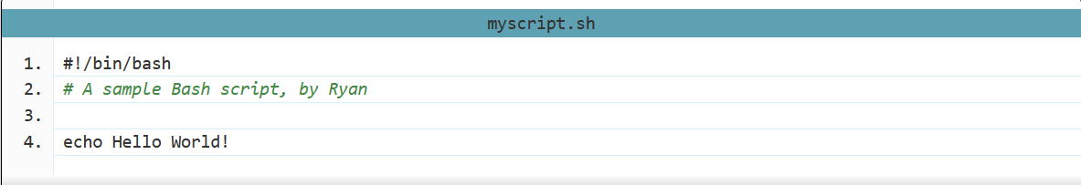
Writing my first script (II)
Start the script with #! /bin/sh
Write some code.
Save the script file as myscript.sh
For executing the script type bash filename.sh
“#!” is an operator called shebang which directs the script to the interpreter location. So, if we use”#! /bin/sh” the script gets directed to the bourne-shell.
Formatting is important here. The shebang must be on the very first line of the file (line 2 won't do, even if the first line is blank). There must also be no spaces before the # or between the ! and the path to the interpreter.
# : This is a comment. Anything after # is not executed. It is for our reference only.

Slide 16
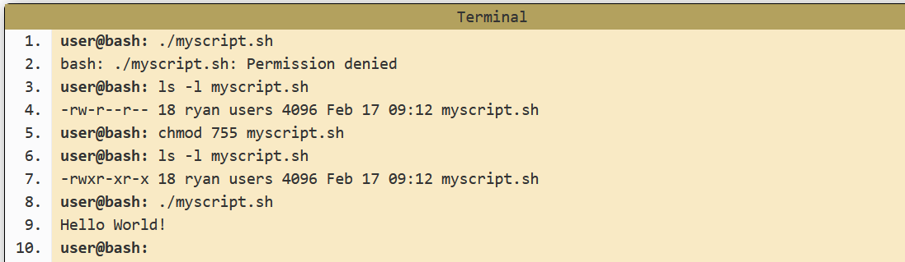
Executing scripts (I)
Before we can execute a script it must have the execute permission set (for safety reasons this permission is generally not set by default).
If you forget to grant this permission before running the script you'll just get an error message telling you as such and no harm will be done.
Assign execution permission:
chmod 755 myscript.sh
or chmod +x myscript.sh

Slide 17
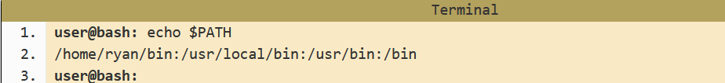
Executing scripts (II)
You've possibly noticed that when we run a normal command (such as ls) we just type its name
… but when running the script above I put a ./ in front of it.
When you just type a name on the command line Bash tries to find it in a series of directories stored in a variable called $PATH.
We can see the current value of this variable using the command echo
The directories are separated by " : "
Bash only looks in those specific directories and doesn't consider sub directories or your current directory. It will look through those directories in order and execute the first instance of the program or script that it finds.

Slide 18
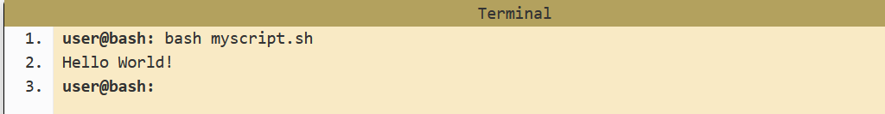
Executing scripts (III)
You can also run Bash, passing the script as an argument.

Slide 19
Variables, parametres

Slide 20
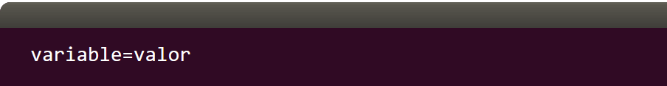
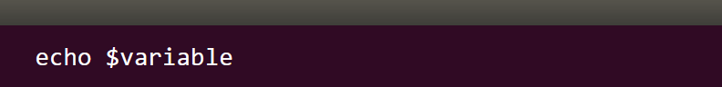
Variables ( I)
A variable is a temporary store for a piece of information. There are two actions we may perform for variables:
Setting a value for a variable.
Reading the value for a variable.
Ámbito de las variables
Las variables en Bash tienen un ámbito global a excepción de que lo definas como local. Esto quiere decir que definas la variable donde la definas, la podrás utilizar en cualquier lugar de tu script.
Sin embargo, si la defines dentro de una función como local esta solo tendrá aplicación en la propia función

Slide 21
Exporting variables ( I)
Variables are limited to the process they were created in. Normally this isn't an issue but sometimes, for instance, a script may run another script as one of its commands. If we want the variable to be available to the second script then we need to export the variable.
Exporting variables is a one way process. The original process may pass variables over to the new process but anything that process does with the copy of the variables has no impact on the original variables.
Shell variables (defined without export) are like local variables that we can access only within that shell.
Environment variables (defined with export) are like global variables that we can access within the defining shell and all its child shells, processes, and commands.

Slide 22
Exporting variables ( II)
The first definition creates a variable named MYVAR and assigns it the value 1729. This is a shell variable.
The second definition creates a variable named MYVAR, assigns it the value 1729, and marks it for export to all child processes created from that shell. This is an environment variable.
Removing a Variable From export, xport provides a command-line option -n to remove a variable from export:
$ MYVAR=1729
$ export MYVAR=1729
$ export-n USER
$ bash # Open a new child shell again
$ echo $USER
$

Slide 23
Parameters ( I)
A bash shell script have parameters. These parameters start from $1 to $9.
When we pass arguments into the command line interface, a positional parameter is assigned to these arguments through the shell
Parameters | Function
$1-$9 | Represent positional parameters for arguments one to nine
${10}-${n} | Represent positional parameters for arguments after nine
$0 | Represent name of the script
$∗ | Represent all the arguments as a single string
$@ | Same as $∗, but differ when enclosed in (")
$# | Represent total number of arguments
$$ | PID of the script
$? | Represent last return code

Slide 24
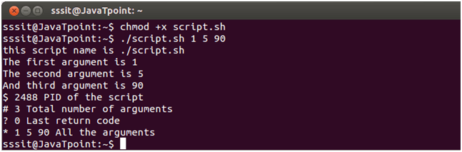
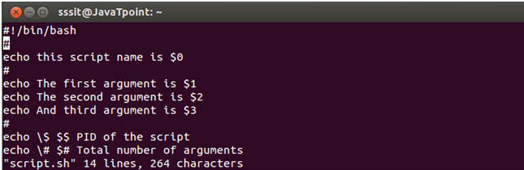
Parameters ( II)
Example script with parameters:
Look at the above snapshot, we have passed arguments 1, 5, 90.
All the parameters show their value when script is run.
.

Slide 25
Environment variables ( I)
Environment variables are special variables (like $HOME) that contain information about your login session. They're stored for the system shell to use when executing commands.
They exist whether you’re using Linux, Mac, or Windows.
Many of these variables are set by default during installation or user creation.
Environment variables are no different, technically, than variables. They can be set, recalled, and cleared with exactly the same syntax used for variables.
You can view all environment variables set on your system with the env command
Or also printenv
$ env

Slide 26
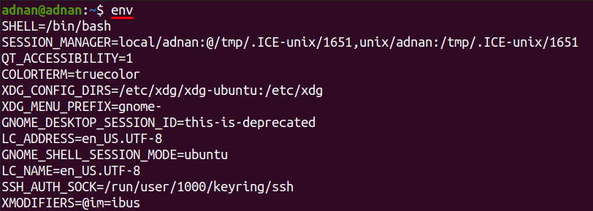
Environment variables ( II)
Example:
Si lo ejecutas puedes encontrar algunas variables tan interesantes como,
$SHELL que indica el shell que estás ejecutando
$EDITOR donde está indicado el editor por defecto. En mi caso vim.
$HOME la ruta del usuario. En mi caso /home/lorenzo
$USERNAME el nombre del usuario. En mi caso Lorenzo 😄
$PATH la ruta por defecto donde encontrar binarios, etc.
$HOSTNAME: nombre del dispositivo..

Slide 27
Assigning values of a command to a variable ( I)
Si volem que una variable tingui com a valor el resultat d'una comanda, tenim 2 formes de fer-ho. Una és amb amb $() i l'altra utilitzant l'accent obert:
o bé utilitzant l'accent obert:
IMPORTANT !!! Don’t’ left any blank space between i, = and $
$avui=$(date)
$ avui=`date`
$ echo $avui
dt feb 16 15:57:09 CET 2016

Slide 28
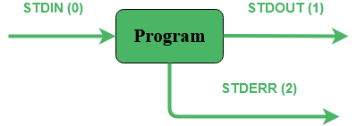
stdin, stdout i redireccions a arxius
Having the program as our black box, we can imagine three main fluxes of data coming in and out from it:
STDIN – Input – Associated file descriptor on startup: 0
STDOUT – Output – Associated file descriptor on startup: 1
STDERR – Error – Associated file descriptor on startup: 2

Slide 29
stdin
L'entrada estàndard sol ser el teclat, i la llegim amb read ( veruem més endavant amb detall) :
Al tanto amb els caràcters especials. Si volem imprimir una cometa doble saldrá utilizar el ESCAPE CHARACTER "\".
A stdin també podem redirigir-hi els continguts d'un arxiu. Això es pot fer de 2 maneres
Amb la "tuberia" pipe "|“
Amb "<":
read entrada
echo "has dit \"$entrada\""
$ cat directori.txt | grep txt
$ grep txt < directori.txt

Slide 30
stdout
Podem redirigir stdout d'un programa cap a un arxiu amb ">" , per exemple (OJU, esborrarem tots els continguts del fitxer destí):
Podrem veure els continguts del directori fent:
Podem AFEGIR dades a l'arxiu amb ">>":
Comprovem amb:
$ ls -la > directori.txt
$ cat directori.txt
$ echo “Hola” >> directori.txt
$ cat directori.txt

Slide 31
stderr
Però si cometem un error en la comanda, el missatge d'error ens apareix a stderr, que continua sent la pantalla:
Si volem redirigir stderr ho podem fer amb 2>, per exemple:
...ara el missatge d'error no ens apareix, però el trobarem dins de l'arxiu "errors.txt".
Si volem juntar stderr + stdin podem fer-ho afegint 2>&1 al final de la comanda:
$ ls -la aaa > directori.txt
ls: no s’ha pogut accedir a aaa: El fitxer o directori no existeix
$ ls -la aaa > directori.txt 2> errors.txt
$ ls -la aaa > directori.txt 2>&1

Slide 32
Ordres més habituals

Slide 33
echo ( I)
Echo: El comando interno echo es muy simple pero muy útil como se verá.
Sirve para escribir sus argumentos en la salida estándar (la pantalla por defecto).
Se pueden usar los denominados caracteres de escape (\ n, \ t, etc., ver con
help echo), pero para que tengan efecto hay que especificar la opción -e:
En el ejemplo siguiente vemos que lo que muestra echo no es el texto que lo
Acompaña como argumento, sino el resultado de la expansión de la variable PATH:
$$ echo Hola mundo
Hola mundo
$ echo -e "Hola mundo\nAdiós mundo"
Hola mundo
Adiós mundo
# echo $PATH
/usr/local/sbin:/usr/local/bin:/usr/sbin:/usr/bin:/sbin:/bin

Slide 34
echo ( II)
Aquí tenemos que advertirte algo. Si has envuelto tu cadena entre comillas simples, echo tratará todo de forma literal. Para mostrar el valor de la variable y no el nombre de la variable, tienes que utilice comillas dobles.
Si usaste el operador de redirección “>”, el archivo se crea si este no existe. Si el archivo de hecho existe, la salida de echo se agrega al comienzo de dicho archivo, sobrescribiendo cualquier contenido anterior que tenga almacenado.
Si utilizas el operador de redirección “>>”, el archivo se crea si no existe. La salida de echo se agrega al final del archivo y no sobrescribe ningún contenido existente del archivo en cuestión.
$echo ‘Mi nombre es $ my_name’
$echo “Mi nombre es $ my_name”
$echo «Creating a new file.» > sample.txt
$echo «Adding to the file.» >> sample.txt
$cat sample.txt

Slide 35
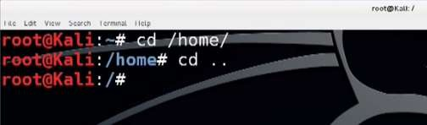
cd, clear
cd (change directory): change the current working directory to ‘directory’
cd… using for one step back.
clear : Clear all text on the screen and display a new prompt.
$clear

Slide 36
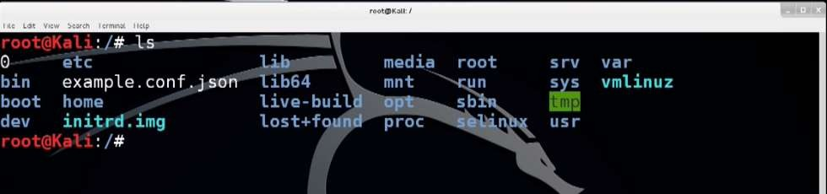
ls
ls (list) : showing listing of the current folders
Some useful parameters:
Parameters | Function
-a | shows all files included hidden ones
-l | shows file or directory, size, modified date and time, file or folder name and owner of the file, and its permission.
-lh | shows sizes in a human-readable format
-r | Recursively list Sub-Directories in Linux
36

Slide 37
pwd, cp
pwd (print working directory): print name of current working directory.
$ pwd
cp (copy): Copy from source to dest
$ cp [options] source dest
Examples:
Copy 2 files main.c and def.h to destination absolute path directory
/home/usr/rapid/ :
Copy all C files in current directory to subdirectory bak :
$ cp main.c def.h /home/usr/rapid/
$ cp *.c bak
37

Slide 38
pwd, cp
cp command main options:
Option | Description
cp -a | archive files
cp -f | force copy by removing the destination file if needed
cp -i | interactive - ask before overwrite
cp -R | recursive copy (including hidden files)
cp -u | update - copy when source is newer than dest
cp -v | verbose - print informative messages
38

Slide 39
mv
mv (move): move from one directory place to another either rename
of the current folder/file
$ mv [options] source dest
Examples:
Move all files in subdirectory bak to current directory :
Rename file main.c to main.bak:
$ mv bak/* .
$ mv main.c main.bak
39

Slide 40
Less, cat
less:
less is a terminal pager program on Unix, Windows, and Unix-like systems
used to view (but not change) the contents of a text file one screen at a time.
It is similar to more, but has the extended capability of allowing both forward
and backward navigation
cat: used to in display files on print screen
Examples:
Updates the content as the files is modifying;
Print a file in screen
$ less +F /var/log/syslogk
$ cat /etc/passwd
40

Slide 41
grep ( I)
El comando grep nos permite buscar cadenas de texto y palabras dentro de un fichero de texto o de la entrada estándar de la terminal.
Una vez encontrado el contenido que estamos buscando:
grep mostrará en pantalla la totalidad de la línea/s que contiene/n la cadena de texto o palabra que estamos buscando.
Con la opción pertinente únicamente mostrará la cadena de texto o palabra de cada una de las líneas que coincide con nuestro criterio de búsqueda.
Para usar grep tendremos que usar un comando del siguiente tipo:
$ grep opcion/es 'cadena_de_texto' fichero_donde_buscar
Un ejemplo básico de uso del comando grep sería el siguiente:
$ grep -w 'geekland' geekland.txt
41

Slide 42
grep ( II)
Esto hará que podamos usar grep para conseguir los siguientes propósitos:
Hacer que únicamente se muestren las líneas descomentadas en un fichero de configuración.
En función del contenido de un fichero determinar la acción a realizar.
Extraer contenido de un fichero como por ejemplo direcciones IP.
Contar el número de líneas en las que aparece una palabra o cadena de texto.
Buscar de forma recursiva el nombre de los ficheros que contienen una determinada palabra o cadena de texto.
42

Slide 43
grep ( III)
con grep encontraremos cualquier texto en cualquier archivo
Antes que nada explicaremos las opciones disponibles:
Option | Description
-i | no diferenciará entre mayúsculas y minúsculas.
-w | fuerza que sólo encuentre palabras concretas.
-v | selecciona las líneas que no coinciden.
-n | muestra el número de la línea con las palabras de solicitadas.
-r | busca directorios recursivamente
-R | como -r pero sigue todos los enlaces simbólicos.
-l | muestra sólo nombres de archivos con las líneas seleccionadas
-c | muestra sólo una cuenta por archivo de las líneas seleccionadas
--color | muestra los patrones coincidentes en colores
-h | elimina el prefijo del nombre del archivo Unix en la salida
43

Slide 44
grep ( IV)
Cómo realizar búsquedas recursivas. Por ejemplo, leer todos los archivos de cada directorio que contengan la palabra «Pablinux». Para ello escribiremos:
$ grep -r Pablinux /home/
A veces hay archivos que contienen lo que queremos buscar algo más. Por ejemplo, esto nos puede pasar en palabras compuestas y buscando «bosques» podemos encontrar «guardabosques». Si queremos encontrar una palabra exacta usaremos la opción -w:
$ grep -w bosques /home/pablinux/Documentos/vacaciones.txt
grep también es capaz de contar cuántas veces aparece una palabra en un archivo.
Para ello usaremos la opción -c:
$ grep -c prueba /ruta/al/archivo
44

Slide 45
grep ( V)
grep no solo es capaz de buscar dentro de archivos. También es capaz de mirar información del sistema. Para ello hemos usado el comando:
O :
$ cat /proc/cpuinfo | grep -i 'Model'
$ grep -i 'Model' /proc/cpuinfo
Si queremos ver una lista con sólo los nombres de los archivos que coinciden con una búsqueda usaremos la opción -l como se muestra a continuación:
$ grep -l 'main' *.c
Y si queremos ver la palabra en colores escribiremos:
$ grep --color palabra /ruta/al/archivo
45

Slide 46
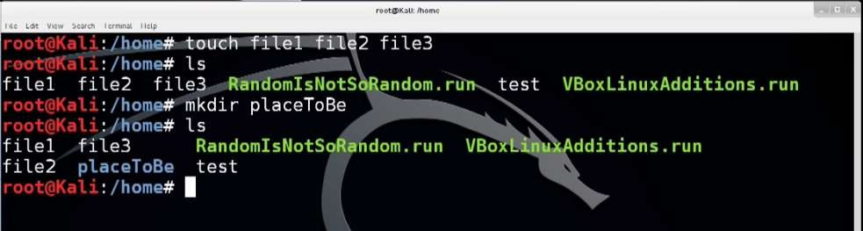
touch, mkdir
touch: very quick way to create new, empty files.
mkdir: make a directory.
En el siguiente ejemplo el usuario tiene privilegios de lectura, escritura y ejecución,
el grupo de lectura y ejecución y el resto ningún privilegio.
Lo mismo que en ejemplo anterior pero en octal:
$ mkdir -m u=rwx,g=rx,o= temporal
$ mkdir -m 750 temporal
46

Slide 47
chmod
chmod: CHMOD ("Change mode") es un comando UNIX/LINUX que permite cambiar los permisos de acceso de un archivo. Cada archivo tiene nueve clases de acceso, que pueden ser permitidas o denegadas. Se pueden aplicar diferentes permisos al dueño del fichero, al grupo al que el fichero pertenece y al resto de usuarios.
Cada una de estas tres clases de usuarios (dueño, grupo, resto de usuarios) puede tener permisos de lectura, escritura y ejecuciónvery quick way to create new, empty files.
Posición de la cifra | Significado
1 | Corresponde a la clase de usuario “propietario” (user).
2 | Corresponde a la clase de usuario “grupo” (group).
3 | Otros. Cualquier otra persona
47

Slide 48
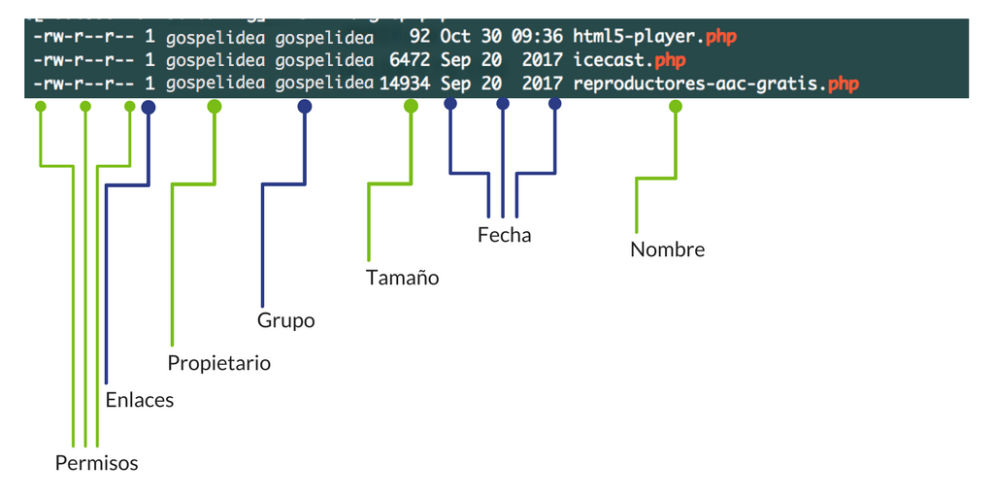
chmod ( II)
- | The first character represents the file type: "-" for a regular file, “d" for a directory, "l" for a symbolic link.
rw- | The next three characters represent the permissions for the file's owner: the owner may read from, write to
r-- | The next three characters represent the permissions for members of the file group. Any member of the file's owning group may read
r-- | The permissions for "others" (everyone else). Others may only read this file.
1 | The number of hard links to this file.
48

Slide 49
chmod ( III)
puede tener los siguientes permisos (por cada tipo de usuario):
4 = lectura
2 = escritura
1 = ejecución
6 (4+2)= lectura y escritura 5 (4+1)= lectura y ejecución 3 (2+1)= escritura y ejecución 7 (4+2+1)= lectura, escritura y ejecución
Valor | Derecho(s) de acceso
0 | Ninguno
1 | Solo ejecutar
2 | Solo escribir
3 | Escribir / ejecutar
4 | Solo leer
5 | Leer / ejecutar
6 | Leer / escribir
7 | Todos los permisos
49

Slide 50
chmod ( IV)
Set the permissions of file.htm to "owner can read and write; group can read only; others can read only".
Recursively (-R) Change the permissions of the directory myfiles, and all folders and files it contains, to mode 755. User can read, write, and execute; group members and other users can read and execute, but cannot write.
Change the permissions for the owner of example.jpg so that the owner may read and write the file. Do not change the permissions for the group, or for others.
$ chmod 644 file.htm
$ chmod -R 755 myfiles
$ chmod u=rw example.jpg
50

Slide 51
rm
rm: removes each file specified on the command line. By default, it does not remove directories.
When rm is executed with the -r or -R options, it recursively deletes any matching directories, their subdirectories, and all files they contain
Examples :
Remove all .pdf files in the current directory, use the following command
To remove files without prompting, even if the files are write-protected, pass the -f (force) option to the rm command:
To remove non-empty directories and all the files without being prompted, use rm with the -r (recursive) and -f options ( testGit is a directory)
$ rm *.pdf
$ rm –f test.txt
$ rm –rf testGit
51

Slide 52
tar ( I)
The tar command is used to rip a collection of files and directories into a highly compressed archive file commonly called tarball or tar, gzip and bzip in Linux.
The tar is the most widely used command to create compressed archive files that can be moved easily from one disk to another disk or machine to machine
Examples :
Create a .tar file with content of directory /home/tecmint:
Create a tar.gz Compressed Archive
$tar -cfv <archive> <file(s) or location(s)>
$tar -cfv tecmint-14-09-12.tar /home/tecmint/
$tar -czf files.tar.gz files
52

Slide 53
tar ( II)
Examples :
Create tar.bz2 Compressed Archive The bzip2 is a file compression program and an alternative to gzip. Add the -z option to create a compressed GNUzip (gzip)
For example, create a tar archive with the files directory and remove it from the disk in one command:
For example, to create a directory named extracted_tar and extract the files from files.tar, run:
$tar cjf files.tar.bz2 files
$tar cf files.tar files --remove-files
$mkdir extracted_tar && tar xfC files.tar extracted_tar
53

Slide 54
tar ( III)
Examples :
For example, to create a directory named extracted_tar and extract the files from files.tar.bz2 run:
Append Files to Archive: Append files to an existing archive using the -r tag. The syntax is:
Find a File in an Archive: Use the tar together with the grep command to filter the output. We want to find file50,txt in archived files.tar.gz
$ mkdir extracted_bz2 && tar xjfC files.tar.bz2 extracted_bz2
$tar rf <archive name>.tar <file(s) or location(s)>
$tar rf files.tar files.tar.gz
tar tf <archive> | grep <file(s)>
$ tar tf files.tar.gz | grep file50.txt
54

Slide 55
Top / quizá mejor ps o lsof para manejar procesos
top: top program provides a dynamic real-time view of a running system. It can display system summary information, and a list of processes or threads currently being managed by the kernel.
-b option: Starts top in 'Batch' mode, which could be useful for sending output from top to other programs or to a file. In this mode, top does not accept input and runs until the iterations limit you've set with the '-n' command-line option, or until killed.
55

Slide 56
Arithmetic expressions ( I)
Below are the operators supported by bash for mathematical calculations:
Operator | Usage
+ | addition
- | subtraction
* | multiplication
/ | division
** | exponentiation
% | modulus
The format for the Bash arithmetic expansion is $(( arithmetic expression )). Numerical expressions can also be calculated and stored in a variable using the syntax below:
#!/bin/bash
var=$((3+9))
echo $var
56

Slide 57
Arithmetic expressions ( II)
Natively, Bash can only do integer arithmetic, if you need to do arithmetic operations that requires floating-point
Since you can’t do floating-point arithmetic natively in Bash, you will have to use a command-line tool. The most common one is “ bc - An arbitrary precision calculator language”.
$ echo "2.5+3.75" | bc
6.25
$echo "15.6+299.33*2.3/7.4" | bc
108.6
57

Slide 58
Arrays ( I)
Declaring an array in Bash is easy, but pay attention to the syntax. If you are used to programming in other languages, the code might look familiar, but there are subtle differences that are easy to miss.
Your array declaration will look something like this:
Example 1 : myArray=("cat" "dog" "mouse" "frog”)
Example 2: WORDS=( an array full of things )
WORDS[0]=“an"
WORDS[1]="array"
WORDS[2]=“full"
...
Can have different types inside the same array ( integers, strings..) -> like dictionary
in Python
58

Slide 59
Arrays ( II)
Number of elements of an array:.
${#WORDS[@]}
Bash does not typically require curly braces for variables, but it does for arrays. So you will notice that when you reference an array, you do so with the syntax ${myArray}, but when you reference a string or number, you simply use a dollar sign: $i.
Example: If you want to Access to one element, ${WORDS[i]}. For example to print the first element of array WORDS: echo ${WORDS[0]}.
Example: If you want to add elements to an array, dynamically without knowing the actual index:
arr=()
arr+=(primer)
arr+=(segon)
arr+=(tercer) ...
59

Slide 60
Arrays ( III)
To loop through the array elements. This is like a for each loop in Javascript your code will need to look something like this:
for var in ${WORDS[@]}
do
# printf ens permet escriure sense salt de línia (a diferència del echo que sí el posa)
printf $var
done
Alternatively, you can loop through the indices of the array. This is like a for loop in JavaScript:
for i in ${!myArray[@]};
do
echo "element $i is ${myArray[$i]}"
done
60

Slide 61
Reading Variables From Standard Input (1)
Sometimes you'll need to gather user input and perform relevant operations.In bash, we can take user input using the read command. The read command reads one line of input from the terminal and assigns it to variables give as arguments
Syntax: read var1 var2 var3 ...
Action: reads a line of input from standard input
Assign first word to var1, second word to var2, ...
The last variable gets any excess words on the line.
Example:
#!/bin/bash
echo "Enter a number"
read a
echo "Enter a number"
read b
var=$((a+b))
echo $var
61

Slide 62
Bucle for ( I)
És important recalcar que els bucles (loops) de bash script solen estar basats en llistes, enlloc de índexs. Us poso també com fer un bucle basat en índex (perquè quedi constància, ja que a la pràctica no es fa servir gaire ;)
for a in {5..10}
do
echo $a
done
Bucle de llista (a.k.a. "for each") AQUEST ÉS EL BUCLE QUE HAURIEU D'UTILITZAR HABITUALMENT. Ja sé que us sona més la versió indexada, però per les aplicacions típiques d'administració de sistemes convé acostumar-se a utilitzar el "foreach". orma:
for elem in elements
do
...
done
62

Slide 63
Bucle for ( II)
El típic exemple és un llistat d'arxius d'alguna carpeta, per exemple, /var. En aquest cas posem els noms d'arxius a la variable $arxius (tal i com ho solem fer amb la comanda ls) i després podrem iterar pels seus elements:
arxius=/var/l* # triem només els arxius que comencen per "l"
for elem in $arxius
do
echo "arxiu = $elem"
done
63

Slide 64
Bucle while ( I)
The bash while loop is a control flow statement that allows code or commands to be executed repeatedly based on a given condition:
Example:
while [ condition ];
do
# statements
# commands
done
#!/usr/bin/bash
a=7
while [ $a -gt 4 ];
do
echo $a ((a--))
done
echo "Out of the loop"
64

Slide 65
Strings, bucles i delimitadors amb IFS ( I)
Podem iterar pels diversos elements d'un array, d'una llista i fins i tot d'un string. Podem "partir" (split) un string amb un bucle.
La variable IFS indicarà al for quin serà el caràcter delimitador per iterar:
Prova d'executar-ho tal com es mostra, i després prova-ho amb IFS=",". Comprova que el resultat és el que es mostra a la següent diapositiva:
FRASE="hola que tal?,com ho veus?"
IFS=" "
for elem in $FRASE
do
echo "$elem"
done
65

Slide 66
Strings, bucles i delimitadors amb IFS ( II)
Resultat iteració amb IFS different_
IFS = “ “ | IFS = “,”
hola | hola que tal?
que | com ho veus?
tal?,com
ho
veus
Bash has a built-in simple pattern matching system. It consists of a few wildcards:
* | matches any number of characters
+ | matches one or more characters
[abc] | matches only given characters
66

Slide 67
Strings, bucles i delimitadors amb IFS ( II)
We can extract a substring using the colon (:) operator inside the parameter expansion, providing the starting position of substring and optionally length of the substring:
$ NAME=Baeldung
$ echo ${NAME:6}
ng
$ echo ${NAME:0:4}
Bael
67

Slide 68
Condicional ( I)
The conditional statement is used in any programming language to do any decision-making tasks.
Use of if-else statement: To execute one statement for true condition and another statement for the false condition, if-else statement is used in this example.
#!/bin/bash
echo "Enter your name"
read name
if [[ $name == "Neha" || $name == 'Nil' ]];
then
echo "You have won the prize"
else
echo "Try for the next time"
fi
68

Slide 69
Condicional ( II)
Use of if-elif-else statement: Multiple conditions with multiple if statements are declared in this example to print grade based on input mark
#!/bin/bash
echo "Enter the mark"
read mark
if (( $mark >= 90 ));
then echo "Grade - A+"
elif (( $mark < 90 && $mark >= 80 ));
then echo "Grade - A"
elif (( $mark < 80 && $mark >= 70 ));
then echo "Grade - B+"
elif (( $mark < 70 && $mark >= 60 ));
then echo "Grade - C+"
else echo "Grade - F"
fi
69

Slide 70
Condicional ( III)
The conditional statement is used in any programming language to do any decision-making tasks.
Es pot fer composició de condicions utilitzant && (AND) i || (OR). Hi ha variants antigues utilitzant -a (AND) i -o (OR).
Comparació | Strings | Integers
Igualtat | = | -eq
Diferent de | != | -ne
Menor que | < | -lt
Major que | > | -gt
Major o igual |  | -ge
Menor o igual |  | -le
Cadena nul·la | -z
No és cadena nul·la | -n
70

Slide 71
Condicional per arxius ( I)
Bash té un tractament especialment ràpid per als arxius, ja que és un cas molt comú. Així, tenim condicionals especialment pensats per arxius:
For example:
Directiva | Efecte
-e | l'arxiu Existeix
-s | arxiu existeix i no està buit
-d | existeix i és un Directori
-f | existeix i és un arxiu (File) regular o ordinari
-O | ets propietari de l'arxiu
if [ -e /var/lib/mysql ]
then
echo "probablement tens MySQL instal·lat"
else
echo "si has d'instal·lar MySQL fes servir apt-get install mysql-server"
fi
71

Slide 72
Condicional case ( I)
Aunque el elif resulta muy útil para resolver una gran cantidad de problemas y situaciones, el case representa una mejor opción ya que permite manipular y ver de forma más clara todas las opciones. La sintaxis es la siguiente:.
case expresion in
caso1)
comandos
;;
caso2)
comandos
;;
#...
*)
comandos
;;
esac
72

Slide 73
Condicional case ( II)
Aunque el elif resulta muy útil para resolver una gran cantidad de problemas y situaciones, el case representa una mejor opción ya que permite manipular y ver de forma más clara todas las opciones. La sintaxis es la siguiente:.
#!/bin/bash
#Control de flujo: case
echo "Escribe una frase"
read frase
case $frase in
a*)
echo "La frase empieza con a"
;;
c*t)
echo "La frase empieza con c y termina con t"
;;
*com)
echo "La frase termina con la cadena com"
;;
*)
echo "La frase no cumple con ninguna de las condiciones"
;;
esac
73

Slide 74
Read a file line by line ( I)
Un truc important en els scripts és llegir un arxiu línia a línia per poder processar-lo i aplicar canvis en ell. Sol fer-se a l'estil de les redireccions de stdin, concretament podem llistar l'arxiu /etc/passwd:
while read LINE
do
# processem LINE d'alguna manera
echo $LINE
done < /etc/passwd
74

Slide 75
Read a file line by line ( II)
You can also read field wise. For example, the /etc/passwd has a total of seven fields, and we can read them one by one as follows. First, let us view the file using cat command :
root:x:0:0:root:/root:/bin/bash
daemon:x:1:1:daemon:/usr/sbin:/usr/sbin/nologin
bin:x:2:2:bin:/bin:/usr/sbin/nologin
sys:x:3:3:sys:/dev:/usr/sbin/nologin
....
....
vivek:x:1000:1000:vivek,,,:/home/vivek:/bin/bash
systemd-coredump:x:999:999:systemd Core Dumper:/:/usr/sbin/nologin
lxd:x:998:100::/var/snap/lxd/common/lxd:/bin/false
nvidia-persistenced:x:127:134:NVIDIA Persistence Daemon,,,:/nonexistent:/usr/sbin/nologin
sshd:x:128:65534::/run/sshd:/usr/sbin/nologin
75

Slide 76
Read a file line by line ( III)
In this example, I am going to operate on individual fields within each line by setting additional variables to read, such as f1, f2 and so on :
The Internal Field Separator (IFS) that is used for word splitting after expansion and to split lines into words with the read builtin command.
#!/bin/bash
file="/etc/passwd"
#
# Each input line divided into seven fields separated by a colon (:) character
#
while IFS=: read -r f1 f2 f3 f4 f5 f6 f7
do
# display fields using f1, f2,..,f7
printf 'Username: %s, Shell: %s, Home Dir: %s\n' "$f1" "$f7" "$f6"
done <"$file"
76

Slide 77
Functions ( I)
Functions in Bash Scripting are a great way to reuse code. Think of a function as a small script within a script. It's a small chunk of code which you may call multiple times within your script.
Creating a function is fairly easy. They may be written in two different formats:
OR :
In other programming languages it is common to have arguments passed to the function listed inside the brackets (). In Bash they are there only for decoration and you never put anything inside them.
The function definition ( the actual function itself) must appear in the script before any calls to the function.
.
function_name ()
{
<commands>
}
function function_name
{
<commands>
}
77

Slide 78
Functions ( II)
Example simple function :
.
#!/bin/bash
# Basic function
print_something () {
echo Hello I am a function
}
print_something
print_something
78

Slide 79
Functions ( III)
Passing Arguments: t is often the case that we would like the function to process some data for us.
We may send data to the function in a similar way to passing command line arguments to a script. We supply the arguments directly after the function name. Within the function they are accessible as $1, $2, etc.
.
#!/bin/bash
# Passing arguments to a function
print_something ()
{
echo Hello $1
}
print_something Mars
79

Slide 80
Functions ( IV)
Return Values: Most other programming languages have the concept of a return value for functions, a means for the function to send data back to the original calling location.
Bash functions don't allow us to do this. They do however allow us to set a return status. Similar to how a program or command exits with an exit status which indicates whether it succeeded or not.
We use the keyword return to indicate a return status.
.
80

Slide 81
Functions ( V)
Example:
Remember that the variable $? contains the return status of the previously run command or function..
.
#!/bin/bash
# Setting a return status for a function
print_something ()
{
echo Hello $1
return 5
}
print_something Mars
print_something Jupiter
echo The previous function has a return value of $?
81

Slide 82
Functions ( VI)
Scope refers to which parts of a script can see which variables. By default a variable is global. This means that it is visible everywhere in the script.
We may also create a variable as a local variable. When we create a local variable within a function, it is only visible within that function. To do that we use the keyword local in front of the variable the first time we set it's value.
It is generally considered good practice to use local variables within functions so as to keep everything within the function contained. This way variables are safer from being inadvertently modified by another part of the script
.
local var_name=<var_value>
82

Slide 83
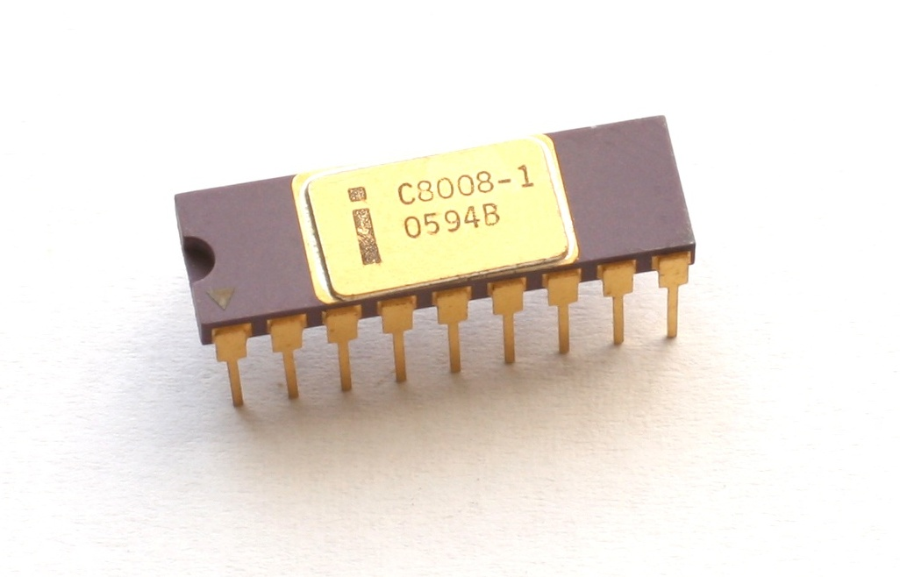
Dels 4 als 8 bits
Evolució cap als processadors de 8 bits (1972)
Intel 8008/8080/8085

Slide 84
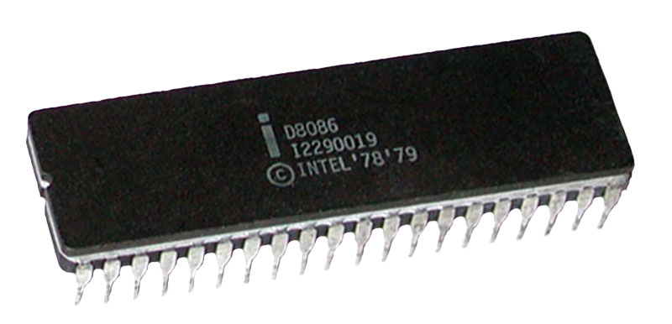
Intel 8086
μProc de 16 bits.
29.000 transistors integrats
Tecnologia de fabricació de 3μm
Freqüència de rellotge de 4,7MHz a 10MHz
Bus de dades de 16 bits
Bus d’adreces de 20 bits (RAM max. 1MB)
16 registres de 4 bits
Empaquetat (socket) DIP 40pins

Slide 85

les FPU i Els primers jocs
Atari Adventure

Slide 86

Els 32 bits
El gran salt. Principis de l’era moderna dels processadors (1985)
Intel 80386

Slide 87
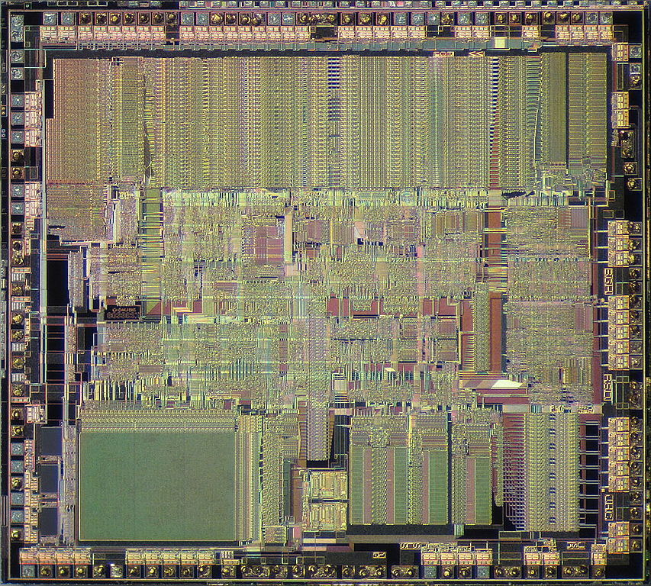
Intel 80386
INtroduit a l’octubre de 1985
Velocitat de rellotge: 16/20/25/33 MHz
Velocitat de processament: 5/6/7,5/9,9 MIPS
Tecnologia de fabricació de 1μm
275.000 transistors integrats
Bus de dades de 32 bits
Bus d’adreces de 32 bits (4GB RAM max.)
Memòria virtual fins a 64TB (≃2⁴⁶)
Primer joc d’instruccions de 32 bits (IA32)

Slide 88



Integració de les FPU
En aquests processadors, ja es va començar a integrar la FPU en un sol xip, si bé en les versions SX del i386 i el i486 existien les FPU externes i387 i i487 respectivament. El Intel Pentium ja tenia la FPU integrada en totes les versions, si bé la casa NexGen va fabricar una versió amb FPU a part (Nx587).
Això va permetre una millora en el rendiment global dels sistemes informàtics.

Slide 89
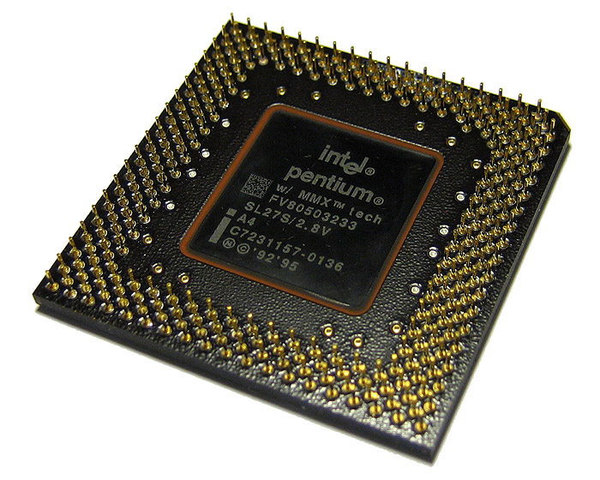
L’era moderna dels processadors
Ampliació dels jocs d’instruccions bàsics de l’arquitectura IA32. Les instruccions complexes per gestió multimedia. (1995)
Les instruccions MMX

Slide 90

64 bits
NetBurst
Família NetBurst
Pentium 4F
Pentium D
Pentium EE (Extreme Edition)
Xeon (64b NetBurst)
La potència dels 64 bits

Slide 91

64 bits
Core
Família Core
Xeon (64b Core)
Pentium Dual-Core
Core 2
Celeron (64b Core)
Celeron M (64b Core)
L’aparició dels multinucli

